Slide 1
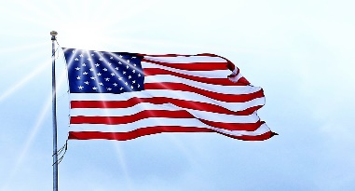
No Fault LLC & LTC are All American!
How about a playground with a red, white and blue patriotic look! That is exactly what we supplied at Northwood High School in Lena, Louisiana. We partnered with Christina Swift, CPSI Certified inspector, of Hahn Enterprises.
Christina told us about this project stating, “Northwood had outdated playground equipment, and desperately needed something new. We designed a playground that had a variety of slides and climbers for the elementary school. This is all new Little Tikes Commercial play equipment which is ADA accessible for kids with special needs, and the added benches give people a place to rest or watch all the action. I love the picture that has the American flag in the background as it matches the equipment!”
For added safety, we worked with Hahn to provide and install our No Fault Safety Surface in an attractive tan color blend. Children with mobility devices will find it easy to move around on the solid, rubber surfacing within this “all American” play area!

